Slide 1

Ramrao Adik Institute of Technology
Department of Computer Engineering
BE MAJOR Project Review 1
On
“Data Download Duplication Alert System”
By
Roll No. Name of Students
21CE1471 Ashish Kesarkar
21CE1102 Sujal Paunikar
21CE1551 Amisha Khorwal
Guided by
Name of Guide

Slide 2
Outline
Abstract
Introduction
Problem Statement
Literature Survey
Methedology
System Implementation
Conclusion and Future Scope
References

Slide 3
Abstract
In today's data-driven landscape, organizations face significant challenges in securing and managing large volumes of sensitive data. The Data Duplication and Anomaly Alert System is designed to safeguard company databases by detecting duplicate data downloads and identifying anomalous user behavior in real time.
This system integrates cryptographic hashing (SHA-256) for file integrity verification, text similarity algorithms (TF-IDF, LSA) for document comparison, and machine learning models (Isolation Forest) for anomaly detection. By continuously monitoring user activities, analyzing download patterns, and applying intelligent threshold-based alerts, the system proactively mitigates risks associated with unauthorized data access, insider threats, and potential security breaches.

Slide 4
Introduction
In modern enterprises, safeguarding sensitive data from unauthorized access and misuse is a critical challenge. Data duplication and anomalous access patterns pose significant security risks, leading to potential data breaches, compliance violations, and operational inefficiencies. To address these issues, the Data Duplication and Anomaly Alert System is designed to detect and prevent unauthorized data downloads, duplicate retrievals, and suspicious user activities in company databases.
This system employs SHA-256 cryptographic hashing to identify duplicate file downloads, text similarity techniques (TF-IDF & LSA) to detect redundant document retrievals, and machine learning models (Isolation Forest) to flag anomalous download behaviors. By continuously monitoring user activity, access logs, and download frequencies, it ensures real-time threat detection and proactive security enforcement.

Slide 5
Problem Statement
Organizations face significant risks due to unauthorized data downloads, duplicate file retrievals, and anomalous user activities within their databases. Excessive duplication leads to data redundancy, storage inefficiencies, and compliance violations, while abnormal access patterns can indicate potential security threats or insider misuse. Traditional monitoring systems often fail to detect subtle duplication patterns and evolving anomalies, leaving sensitive data vulnerable. The Data Duplication and Anomaly Alert System aims to identify duplicate downloads using cryptographic hashing, detect redundant data retrievals through text similarity analysis, and flag unusual user behavior using machine learning-based anomaly detection. This solution enhances data security, optimizes database efficiency, and ensures proactive threat prevention in enterprise environments.

Slide 6
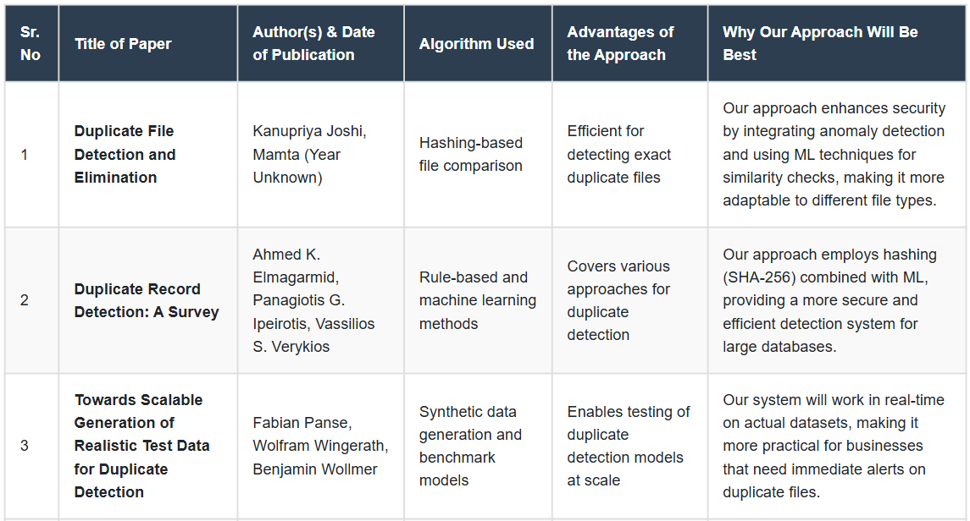
Literature Survey of the existing systems

Slide 7
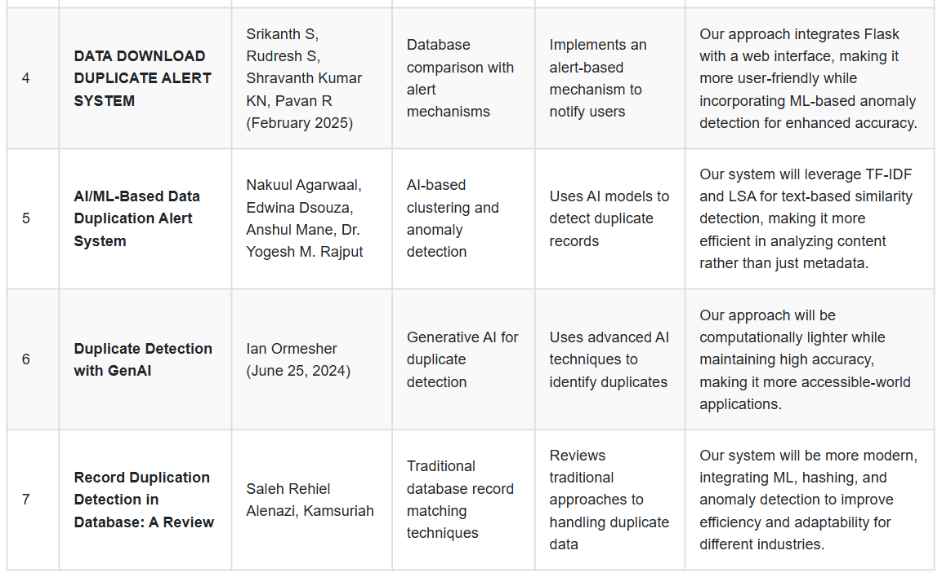
Literature Survey of the existing systems

Slide 8
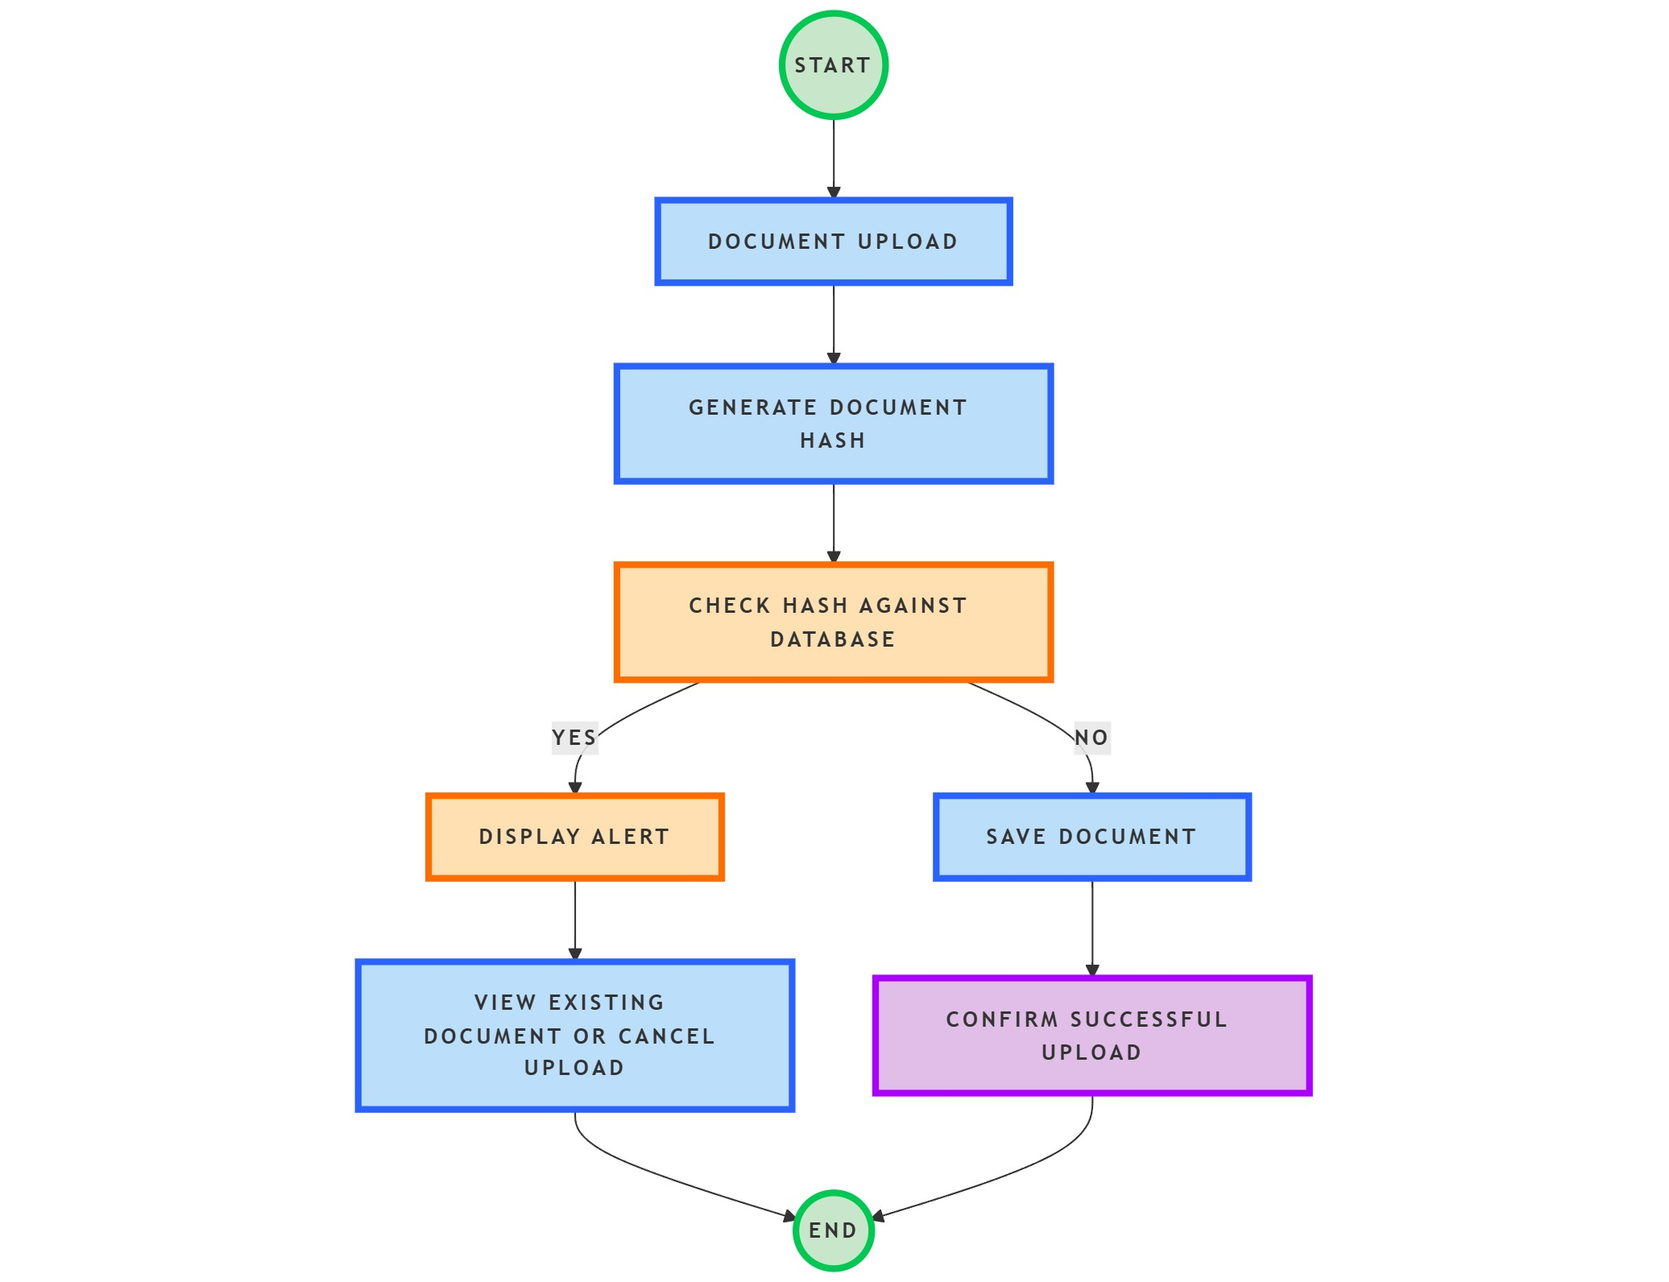
Methedology (System Design)

Slide 9
Methedology (Architecture Used)
Start: Begin with the user initiating the document upload process.
Document Upload: User selects and uploads the document to the system.
Generate Document Hash: The system computes a unique hash value (e.g., MD5, SHA- for the uploaded document. This hash serves as a digital fingerprint for the file.
Check Hash Against Database: The system searches the database for any existing records with the same hash value.
If a Match is Found:
Display an alert to the user indicating that the document already exists in the database.
Provide options to view the existing document or cancel the upload.
If No Match is Found:
Proceed to save the new document and its hash value into the database.
Confirm successful upload to the user.
End: The process concludes.

Slide 10
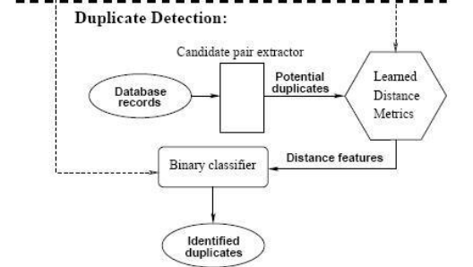
Methedology

Slide 11
Conclusion
The Data Duplication and Anomaly Alert System provides a proactive approach to securing enterprise databases by detecting duplicate downloads and anomalous user behavior. By leveraging cryptographic hashing, text similarity analysis, and machine learning-based anomaly detection, the system ensures data integrity, prevents misuse, and enhances security compliance. This solution helps organizations reduce storage inefficiencies, mitigate security risks, and maintain a robust monitoring framework for their sensitive data.

Slide 12
References
[1]. Radu-Ioan,Ciobanu,Valentin Cristea, Ciprian Dobre and Florin Pop, Big Data Platforms for the Internet of Things,2014,Springer
[2]. Flavio Bonomi, Rodolfo Milito, Preethi Natarajan and Jiang Zhu,Fog Computing: A Platform for Internet of Things and Analytics, springer (2014)
[3]. Shintaro Yamamoto, Shinsuke Matsumoto,Sachio Saiki, and Masahide Nakamura Kobe University, 1-1 Rokkodai-cho, Nada-ku, Kobe, Hyogo 657-8501, Japan,Using Materialized View as a Service of Scallop4SC for Smart City Application Services (2014)
[4]. Mukherjee, A.; Datta, J.; Jorapur, R.; Singhvi, R.; Haloi, S.; Akram, W. “Shared disk big data analytics with Apache Hadoop” (18-22 Dec. 2012)

Slide 13
References
[5]. Kudakwashe Zvarevashe1, Dr. A Vinaya Babu, Towards MapReduce Performance Optimization: A Look into the Optimization Techniques in Apache Hadoopfor BigData Analytics (2014)
[6]. Gartner: Hype cycle for big data, 2012. Technical report (2012)
[7]. IBM, Zikopoulos, P., Eaton, C.:Understanding BigData: Analytics for Enterprise Class Hadoop and Streaming Data. 1st edn. McGraw-Hill Osborne Media,New York (2011)
[8]. Schroeck, M., Shockley, R., Smart, J., RomeroMorales, D., Tufano, P.: Analytics: The realworld use of big data. IBM Institute for Business Value—executive report, IBM Institute for Business Value (2012)

Slide 14
References
[9]. Evans, D.: The internet of things—howthe next evolution of the internet is changing everything. Technical report (2011)
[10]. Cattell, R.: Scalable sql and nosql data stores. Technical report (2012)

Slide 15
Thank You

